Slide 1
Arduino project -CPR FEEDBACK DEVICE
Team:-
Arsh Sood
Anurag bansal
Anmol toor
Apurva pandoh
Deepanshu gond

Slide 2
What is cpr?
Cardiopulmonary resuscitation(CPR) is an emergency technique to replenish the blood flow to the heart and brain at the time of heart failure. CPR includes chest compression with artificial respiration.
The general procedure of performing a CPR includes giving two full breaths to the mouth of the patient i.e. mouth to mouth respiration. It is then followed by giving chest compressions to the patient.

Slide 3
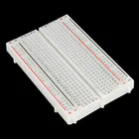
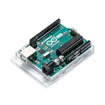
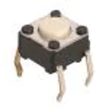
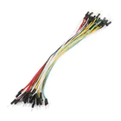
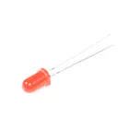
COMPONENTS USED
BREADBOARD (Generic)
ARDUINO UNO
SPARKFUN PUSHBUTTON
SWITCH (12mm)
JUMPER WIRES
LED(Generic)

Slide 4
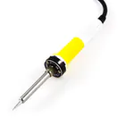
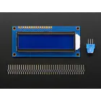
COMPONENTS USED
SOLDERING IRON (Generic)
--> CPR Force sensor
--> Potentiometer
--> ADAFRUIT SENSITIVE RESISTOR
--> ARDUINO IDE (software)
ADAFRUIT STANDARD LCD

Slide 5
workflow
The software used for implementation of the miniaturized CPR feedback device is done initially using the Arduino IDE. The same is then implemented using the MATLAB platform using a file called ArdLAB. ArdLAB folder is added to the path of the folder where the MATLAB code is present. The salient feature of this methodology is that the user can use the same functions used for Arduino IDE software in MATLAB.
The mannequin is represented by a push button switch. The FSR A301 is placed near the push button switch. It also depicts a good CPR as the green LED is ON. The FSR A301 is placed in the analog pin of the Arduino UNO/Mega2560 board. The green and the red LED is placed in the GPIO pins of the Arduino board.

Slide 6
WORKFLOW
The loop is infinite; therefore there will be no STOP. The switch in ON condition increments the CPR count by 1. It measures the processor time for the first count. At the thirtieth count, the end time of the processor is taken. On reaching the fifth cycle, the program is implemented in such a way that the cycle goes back to 1. The switch in OFF condition keeps the CPR count as it is. But it checks whether the count is 30. If the count is 30, then the parameters mentioned before are calculated accordingly.This process continues on till the patient’s heart rate has reached the AHA guidelines.

Slide 7
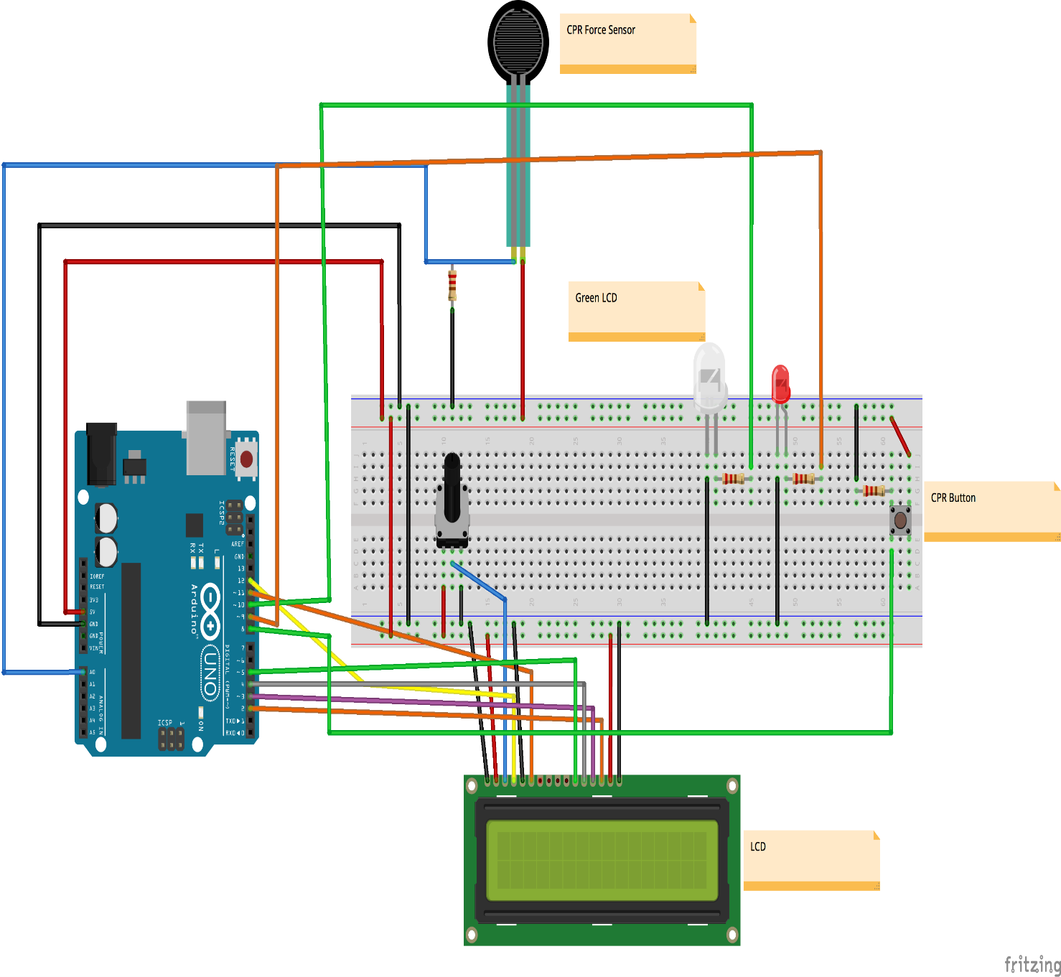
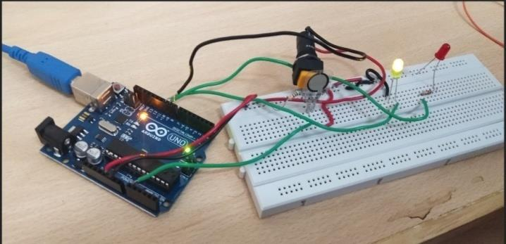
CIRCUIT AND WIRING
The hardware implementation of the miniaturized CPR
device using Arduino.

Slide 8
CALCULATIONS
The number of times a person’s heart beats per minute is called the heart rate.
𝐻𝑒𝑎𝑟𝑡𝑟𝑎𝑡e = (𝐶𝑃𝑅𝑐𝑜𝑢𝑛𝑡 / 𝑇𝑖𝑚𝑒𝑟𝑎𝑡𝑒) × 60
𝑇𝑖𝑚𝑒𝑟𝑎𝑡𝑒 = (𝑇𝑖𝑚𝑒𝑜𝑓𝑙𝑎𝑠𝑡𝑐𝑜𝑚𝑝𝑟𝑒𝑠𝑠𝑖𝑜𝑛 / 𝑇𝑖𝑚𝑒𝑜𝑓𝑓𝑖𝑟𝑠𝑡𝑐𝑜𝑚𝑝𝑟𝑒𝑠𝑠𝑖𝑜𝑛)*1000
𝐻𝑒𝑎𝑟𝑡𝑟𝑎𝑡𝑒 = Bpm Count * 60

Slide 9
Our Vision
In recent times most of the people use automatic digital devices for heart rate calculation but it is not healthy as per AHA guidelines so in recent times Arduino cpr system is promoted,so here we have tried to improve that system to make it easy to carry and works on a small battery.

Slide 10
CONCLUSION
This work proposes the development of a miniaturized CPR feedback device for treating persons suffering from cardiac arrest. The proposed method tracks pressure applied on FSR and number of compressions per minute. Furthermore the equipment is so handy that anyone can use it. Various graphical plots are found out and are analyzed. The results are found out to be reliable with the standard guidelines. This prototype can be further extended by using a mannequin and FSR with higher specification.

Slide 11
THANK YOU

